Slide 1
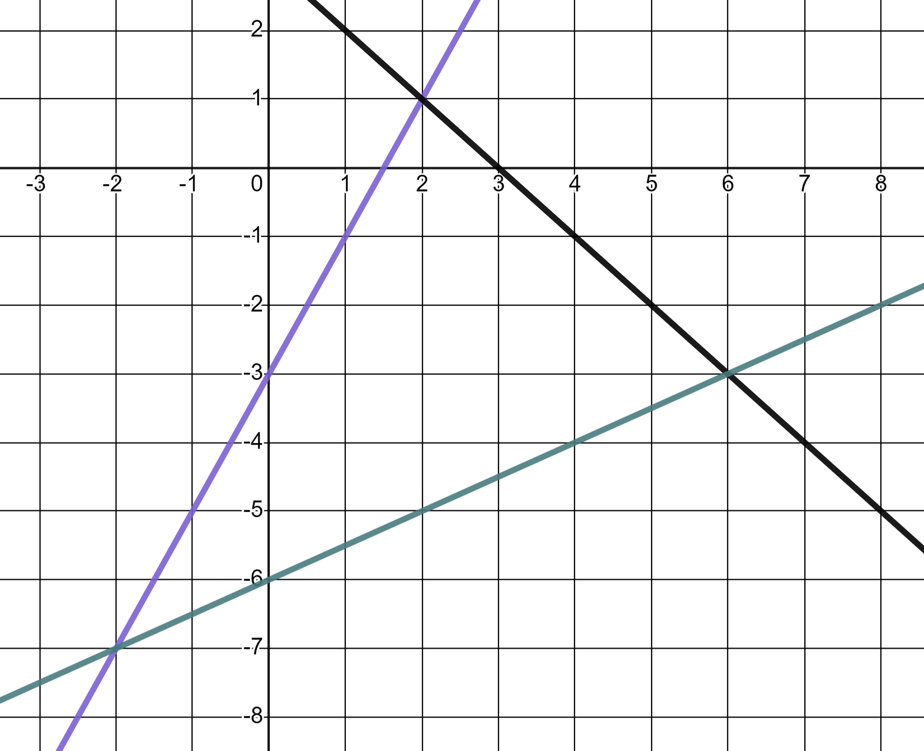
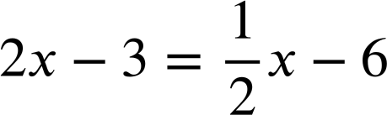
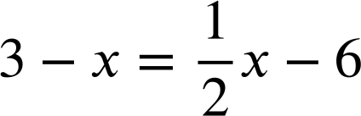
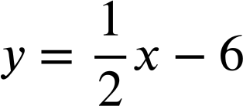
Graphically solving two linear graphs that intersect
Task A: Points of intersection
1) Use these graphs to solve the equations.
y = 2x − 3
a)
2x − 3 = 3 − x
✖
x = 2
b)
x = −2
✖
c)
y = 3 − x
x = 6
✖
2) Use the graphs to solve these pairs of simultaneous equations.
y = 2x − 3
a)
y = 2x − 3
x = 2, y = 1
✖
(2, 1)
y = 3 − x
b)
y = 2x − 3
x = −2, y = −7
(6, −3)
✖
c)
y = 3 − x
x = 6, y = −3
y = 3 − x
✖
(−2, −7)

Slide 2
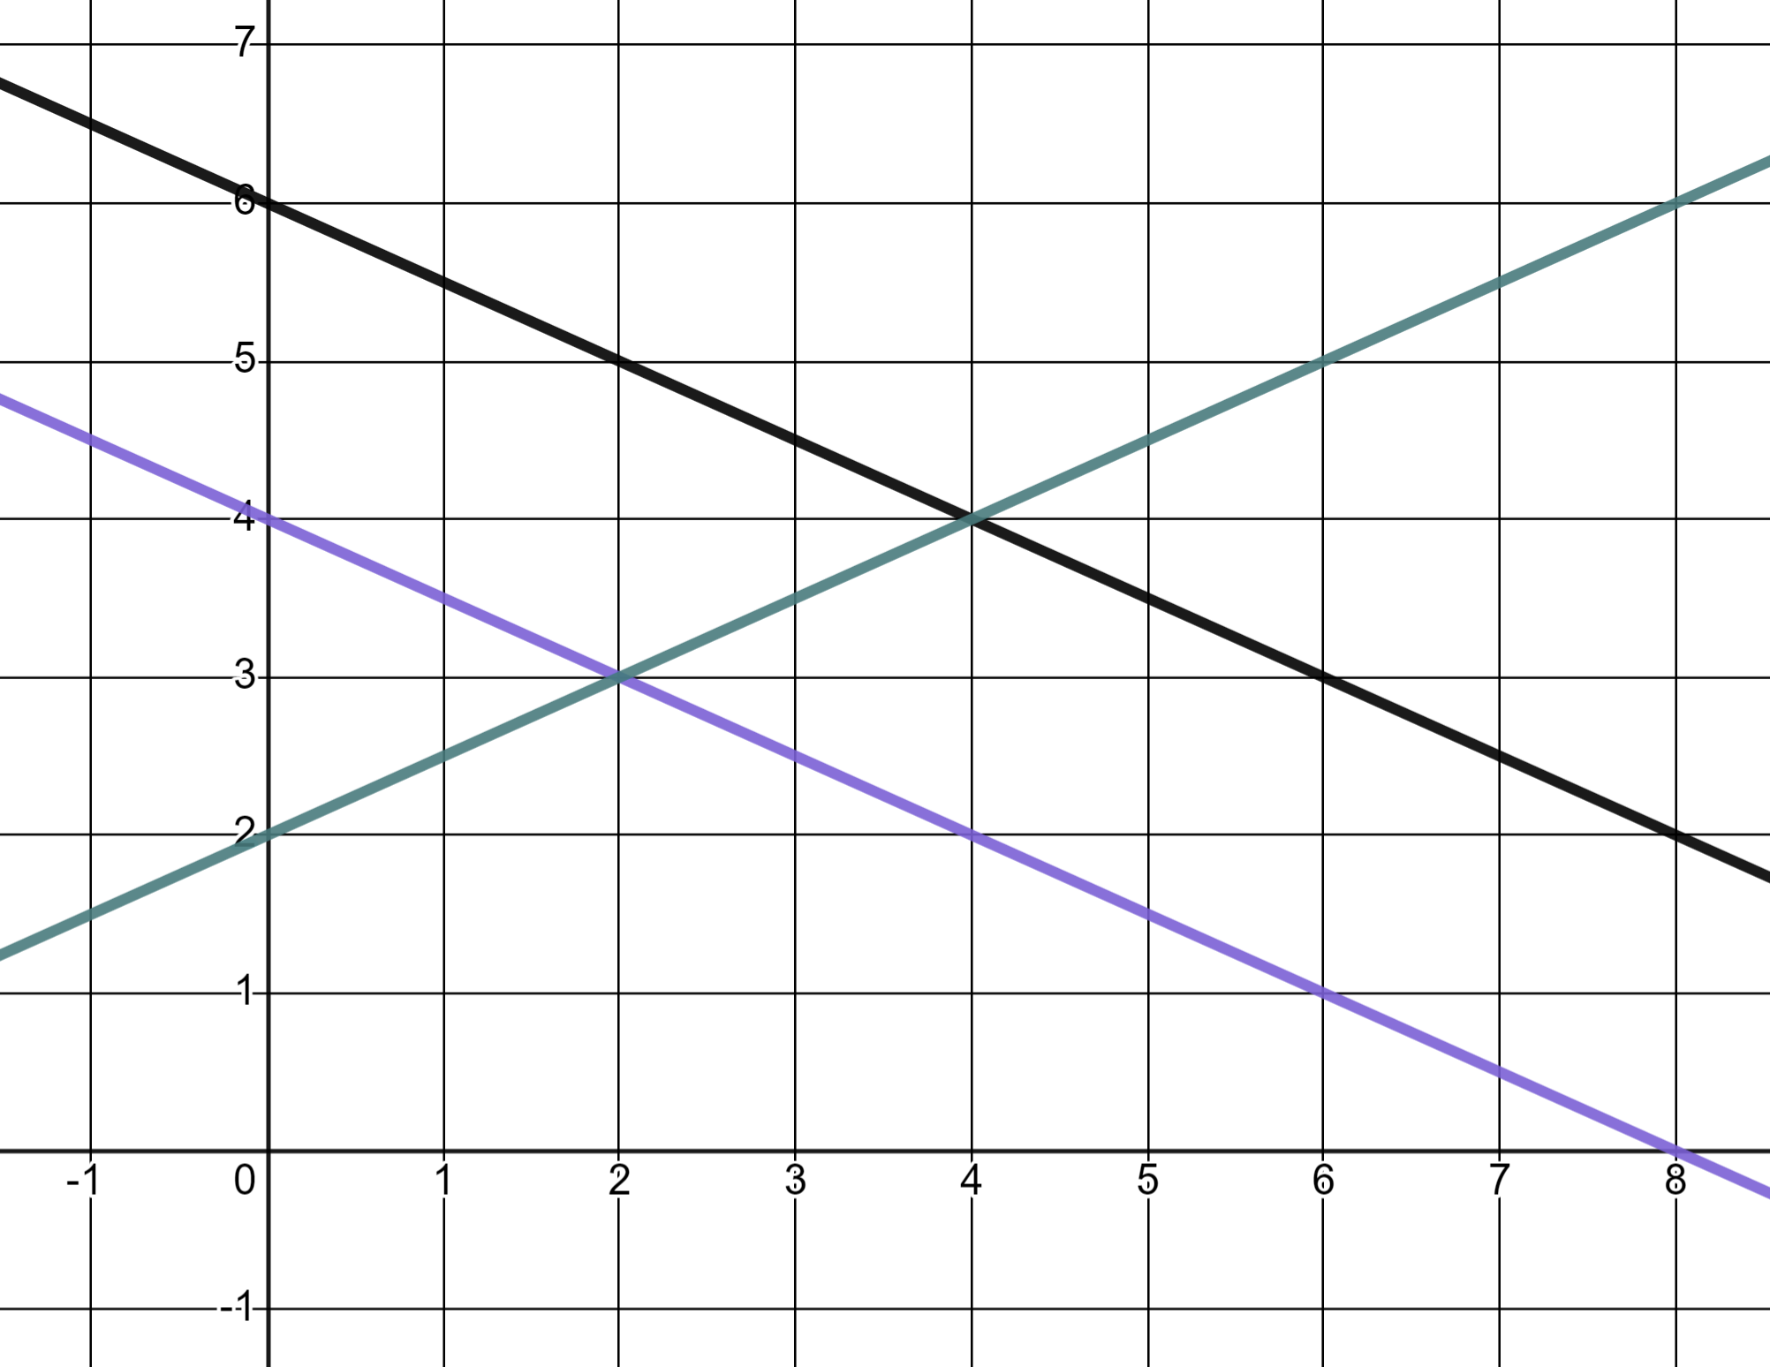
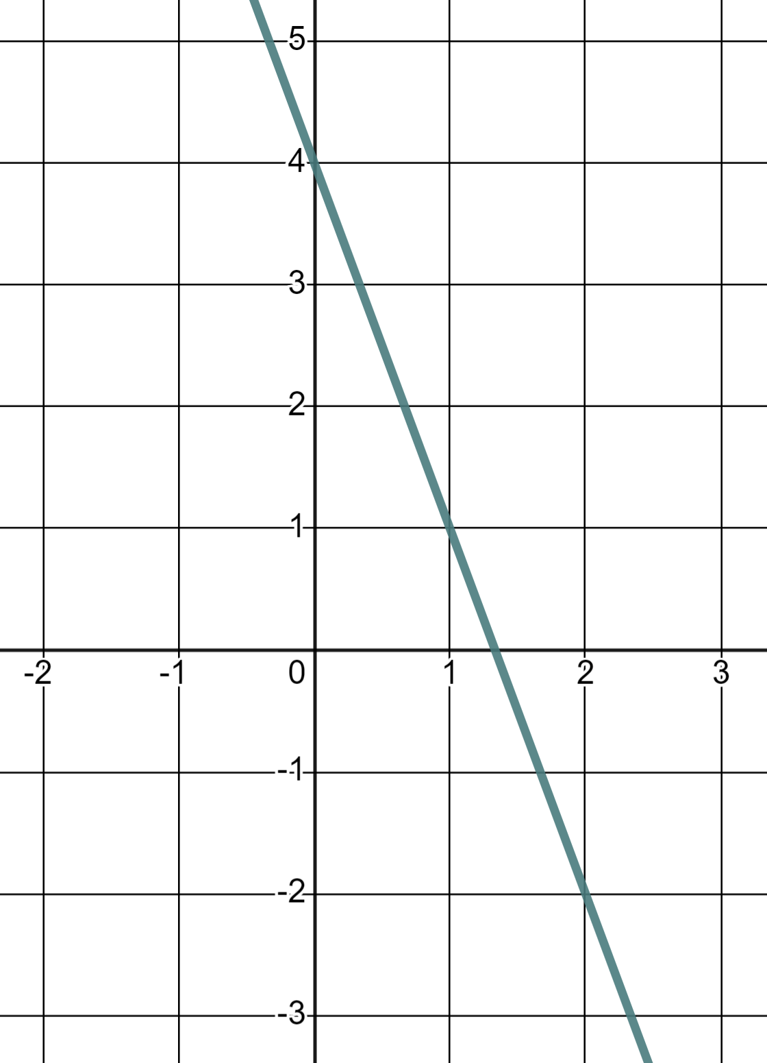
Graphically solving two linear graphs that intersect
3) a) Use the graph to identify two pairs of simultaneous equations which can be solved and find the solutions.
2x + 4y = 24
2y − x = 4
One pair of simultaneous equations:
✖
2x + 4y = 24
The solution:
(4, 4)
2y − x = 4
x = 4, y = 4
✖
(2, 3)
Another pair of simultaneous equations:
2x + 4y = 16
The solution:
2y − x = 4
x = 2, y = 3
2x + 4y = 16
b) Explain why a third different pair of equations can not be found and solved using these particular lines.
Because they are linear equations there are no more intersections (therefore solutions) for the equations we have already highlighted.
The third pair of lines, 2x + 4y = 16 and 2x + 4y = 24 are parallel, therefore have no intersection, no solution.
Task B: Regions of a graph
1) Here is the graph of y = 4 − 3x
y
(1, 5)
(−2, 4)
✖
a) Mark and label three points where y = 4 − 3x
(0, 4)
E.g.
These three coordinates all satisfy the equation y = 4 − 3x
You were not limited to integer value coordinates. Any three coordinates on this line is fine.
✖
✖
✖
(1, 1)
b) Mark and label three points where y < 4 − 3x
(3, 0)
✖
x
These three coordinates all in the region y < 4 − 3x
You were not limited to integer value coordinates. Any three coordinates in the region is fine.
✖
(1.6, −0.8)
(−1, −2)
✖
✖
✖
(0.6, −1.3)
(2.5, −1.5)
c) Mark and label three points where y > 4 − 3x
These three coordinates all in the region y > 4 − 3x
You were not limited to integer value coordinates. Any three coordinates in the region is fine.

Slide 3
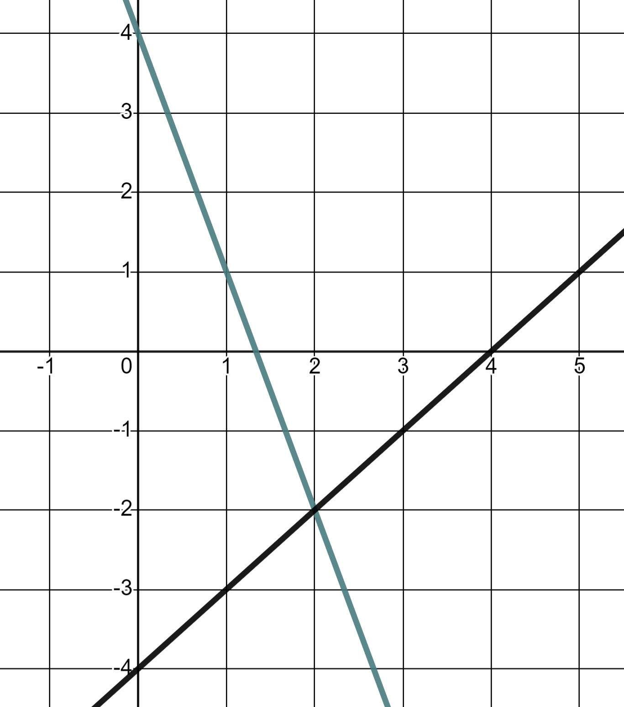
Graphically solving two linear graphs that intersect
2) The lines y = 4 − 3x and y = x − 4
y
(0, 4)
a) Mark and label three points where y = 4 − 3x and y > x − 4
✖
These three coordinates all satisfy the equation y = 4 − 3x and the y-coordinates are all greater than x − 4
You were not limited to integer value coordinates. Any three coordinates on this line in this region are fine.
✖
(1, 1)
✖
x
(1.5, −0.5)
y
b) Mark three coordinates where y < 4 − 3x and y = x − 4
These three coordinates all satisfy the equation y = x − 4 and the y-coordinates are all less than 4 − 3x
You were not limited to integer value coordinates. Any three coordinates on this line in this region are fine.
x
(1.5, −2.5)
✖
✖
✖
(1, −3)
(0, −4)
y
c) Mark and label the one point where y = 4 − 3x and y = x − 4
There is only one coordinate that satisfies these conditions, that of the intersection.
x
✖
(2, −2)
Mathematics in Education and Industry
v2.3

